Slide 1
cognitive modelling
YUHANG JASON LIU

Slide 2
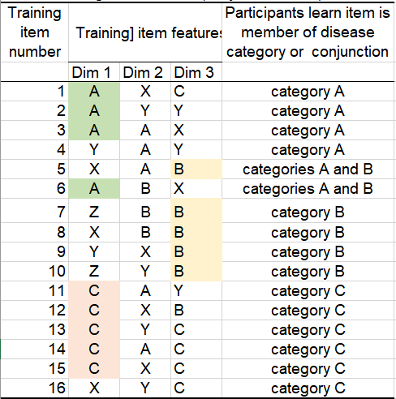
primitive idea
When we are given a whole new set of data waiting to be categorized, what we will probably do first is to find the pattern in it. We are interested in finding out what is the common feature of the records in the same category.
For every disease, there is a dimension which contributes more to the decision than others, for instance:
To determine whether a given case falls into category A, we will probably firstly look at dimension 1, where The majority of category A members have symptom* A under this particular dimension. Moreover, the combination of “Dimension 1 + symptom A” is only seen in category A members, which potentially suggests that this combination is the most critical feature of category A.
Similarly, we can use “Dimension3 + symptom B” for category B and “Dimension 1 + symptom C” for category C as primitive thoughts.

Slide 3

weighting factors
However, it’s not accurate at all to do categorization only depending on the critical symptoms.
Now we need to calculate the weights of different possible symptoms
What are we looking at when calculating the weights?
How frequent is this symptom observed in this dimension?(precision)
How many cases of this symptom are observed inside this category?(recall)
Weight(S, D, C) = $\frac{count of Dy}{count of d in Cz}×\frac{count of D}{count of d in Sx }$
And the score of a piece of new record is the sum of scores from all three dimensions

Slide 4

Weighting factors
Back to the critical features, …
Whichever symptom with $\frac{count of Dy}{count of D in Sx }=1$is given a weight of 1
An empirical shortcut
Cases that have been seen in the training set come into handy when it comes to determining new records. If we have learnt that “AXC” is category A, then next time we see a “AXC” we would know which category it falls into instantly.

Slide 5
CONJUNCTION
To be able to say that a certain piece of record is possibly a conjunction of category A and category B, it must have an enough score to be either A or B. Therefore, my thinking is that I will calculate its score for both A and B, and the minimum value of the two is accepted as the final score.
Score for A&B = Min(Score of A, Score of B)
If either of its score is low, then it’s not very likely to be a conjunction. (Inspired by the Cannikin Law)

Slide 6
RESULTS

Slide 7
REVIEW
Overall acceptable
Works better without conjunctions
Several bad misfits(converted to z-scores):
Case “ABY” for category B
People: 0.14 Model:2.42
Case “XXB” for category A
People: 0.28 Model: -0.74
…
Possible reason: The occurrence of critical symptoms is having too much effect on the calculation

Slide 8

THANK YOU

